Slide 1







Lecture 12:
Introduction to MVC Architecture
Course - Web Development - III
-By
Pratik Raj Verma
welcome@krmangalam.edu.in
Sohna Road,Gurugram,Haryana 122103

Slide 2

| Table of Contents
MVC Architecture
References.
The End.

Slide 3

|
Okay, now we know how to create a server using Express.js…
But do you think companies like Amazon, Netflix, or Instagram write their entire backend inside one single file?

Slide 4
|
Okay, now we know how to create a server using Express.js…
But do you think companies like Amazon, Netflix, or Instagram write their entire backend inside one single file?
Imagine a project with:
500 routes
100 APIs
authentication
database
payment system
If everything is written inside one file, the project will become messy, confusing, and very hard to manage.
That’s why in real industry projects, developers organize backend code in a proper structure.
Instead of writing everything together, we separate responsibilities into different folders and files.

Slide 5
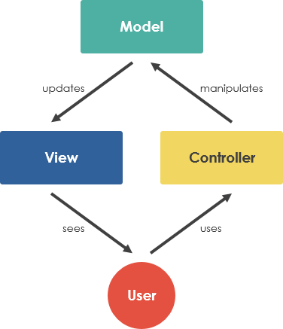

| MVC Architecture
Yes, A big thanks to MVC
MVC helps developers keep backend projects well organized. It separates different work into different sections, which makes the code easier to understand, manage, and update.
It also helps developers build large applications in a clean and scalable way.
MVC

Slide 6
| MVC Architecture
Model Part 📦
Model part handles:
database-related work
schema design
data structure
database interaction
Example:
Student schema
User data
Product data
View Part 🖥️
View part handles:
frontend UI
data display
what users see on screen
Example:
React components
HTML pages
frontend interface
Controller Part
Controller part handles:
backend logic
request handling
response sending
API functionality
Example:
CRUD operations
authentication
business logic

Slide 7
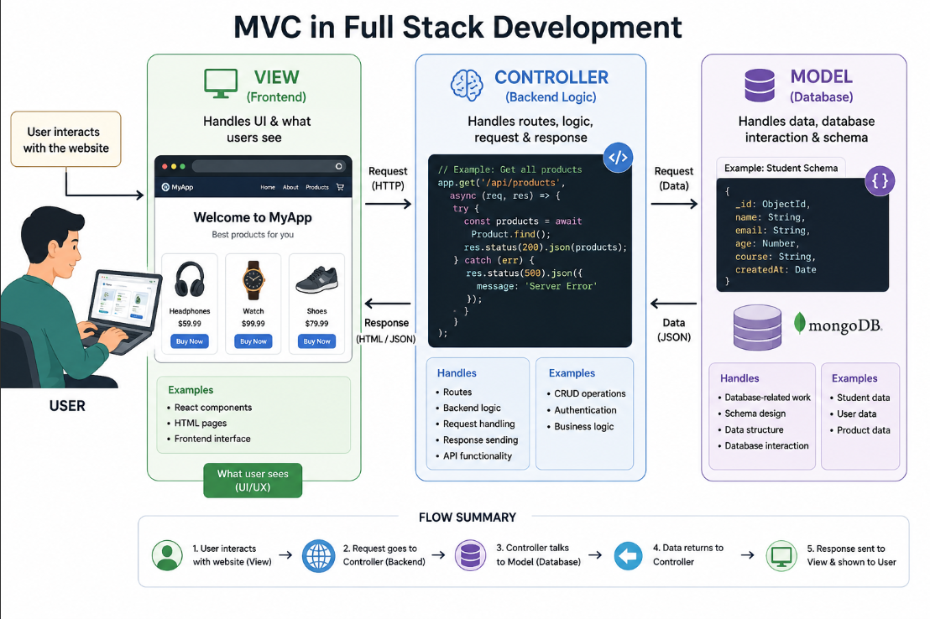
| MVC Architecture

Slide 8
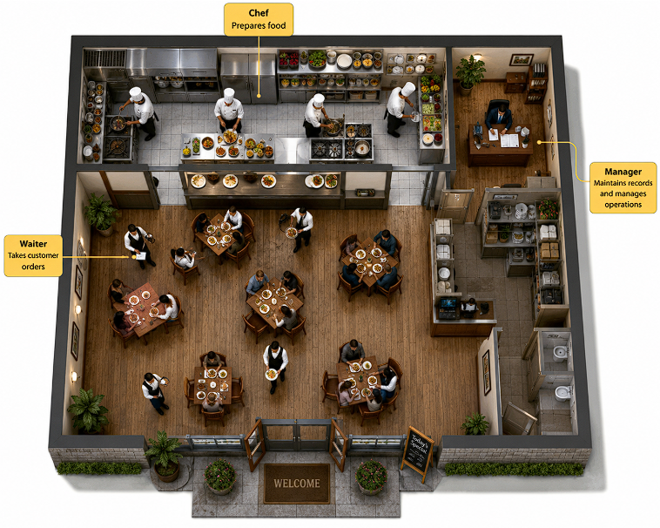
| MVC Architecture
Real-Life Analogy
Imagine a restaurant system:
Role | Responsibility
Waiter | Takes customer orders
Chef | Prepares food
Manager | Maintains records and manages operations

Slide 9
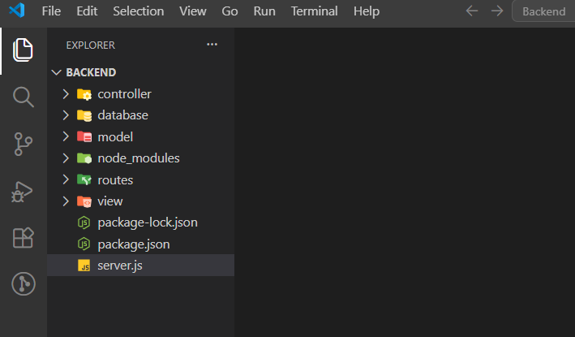
| MVC Architecture
Come on… now let’s build a professional backend project like real industry developers.
Step 1 : Create a file named: server.js
This file will control our entire backend server.
Step 2 : Now create these folders:
—Server
├── routes/
├── controllers/
├── models/
├── database/
└── server.js

Slide 10
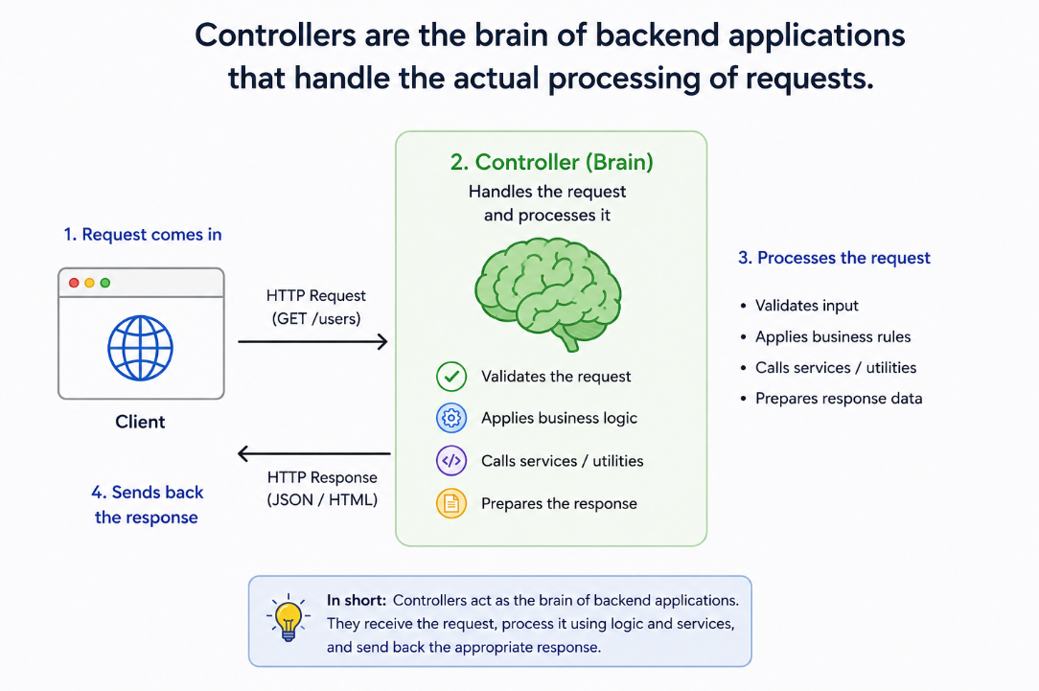
| MVC Architecture
Understanding Each Folder :-
1. controllers Folder:
Controllers contain:
application logic
backend functionality
response handling
Examples:
Create data
Read data
update data
Delete data
Controllers are functions that contain the main backend logic of an application.
They receive requests from routes, process the required operations, and send responses back to the frontend or client

Slide 11
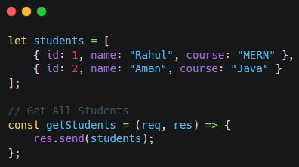
| MVC Architecture
Explanation :
Code Examples:
This array stores student data.
Currently we are not using database, so data is stored inside an array.
getStudents : This is a controller function used to handle the request for getting all students.
Req : It contains data sent by the client/browser.
Res : It is used to send data back to the client.
res.send(students) : send() sends the response. Here, all students data is being sent to the client.
Overall Flow
Client sends request → /students
getStudents() function runs
Server sends all students data back to the client/browser.

Slide 12
| MVC Architecture
2. Routes Folder:
Examples:
/students
/users
/products
Routes handle:
incoming requests
URLs
API endpoints
Routes execute the correct controller function when a request comes from frontend.
Suppose frontend sends request:
GET ====> /students
Frontend Request
↓
Routes
↓
Controller Function
↓
Response Sent Back
Now backend must decide:
which function should run?
which logic should execute?
👉 This decision is made by Routes.

Slide 13
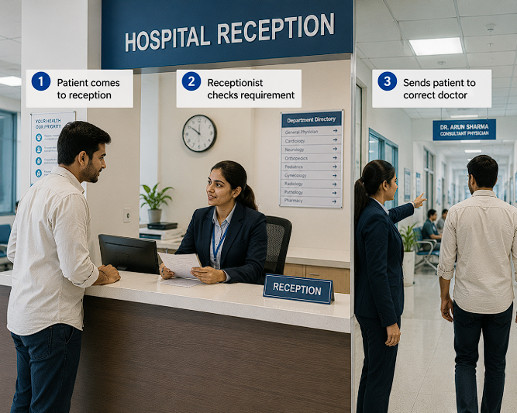
| MVC Architecture
Real-Life Analogy 🚦
Routes = Receptionist
Imagine a hospital:
Patient comes to reception
Receptionist checks requirement
Sends patient to correct doctor
Similarly:
Frontend sends request
Routes receive request
Routes send request to correct controller

Slide 14
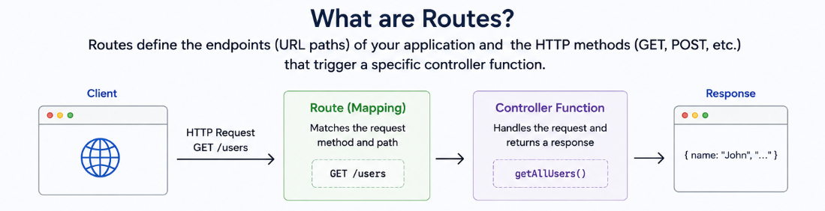
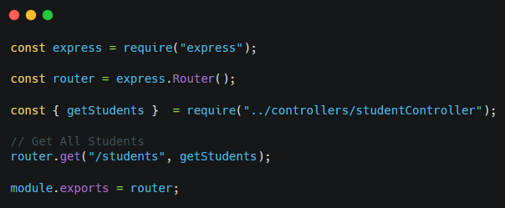
| MVC Architecture
Code Examples:
When frontend requests: GET /students
Then getStudents controller function executes.

Slide 15
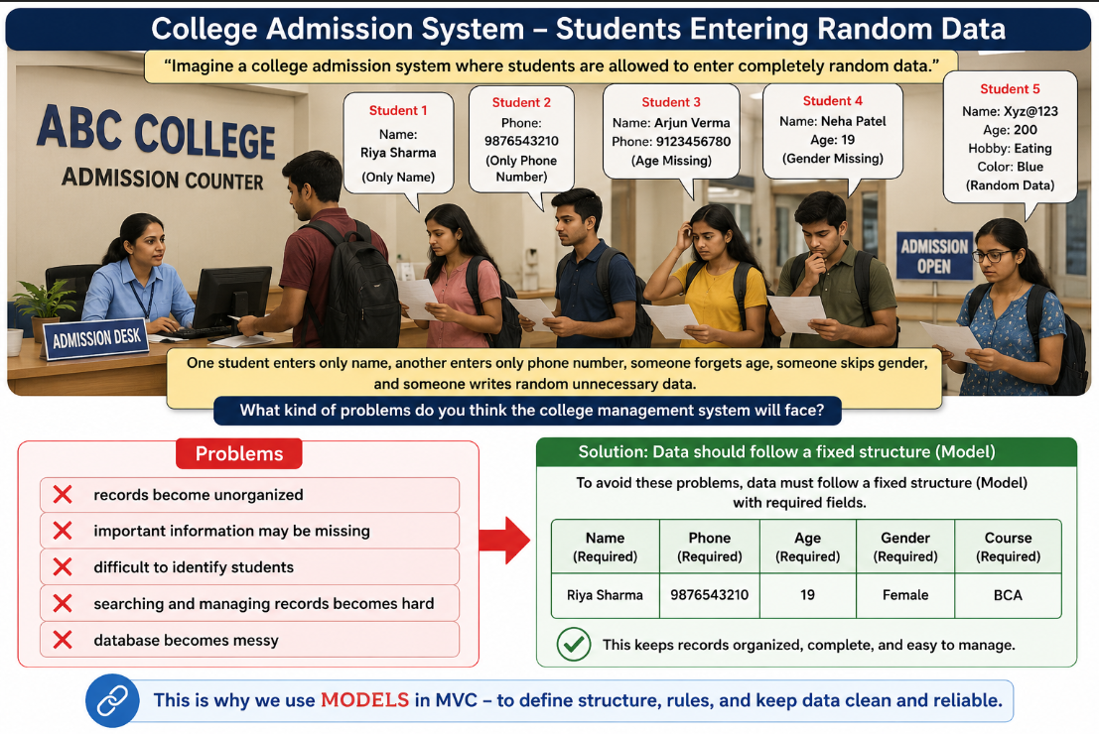
|
Imagine a college admission system where students are allowed to enter completely random data.
One student enters only name, another enters only phone number, someone forgets age, someone skips gender, and someone writes random unnecessary data.
What kind of problems do you think the college management system will face ?
models

Slide 16
| MVC Architecture
Understanding Each Folder :-
3. Models Folder:
Models are components in MVC architecture that manage application data, define data structure, and interact with the database inside backend applications.
Models handle:
data
schema
database structure
database-related operations
They define:
what type of data will be stored
how data should look

Slide 17
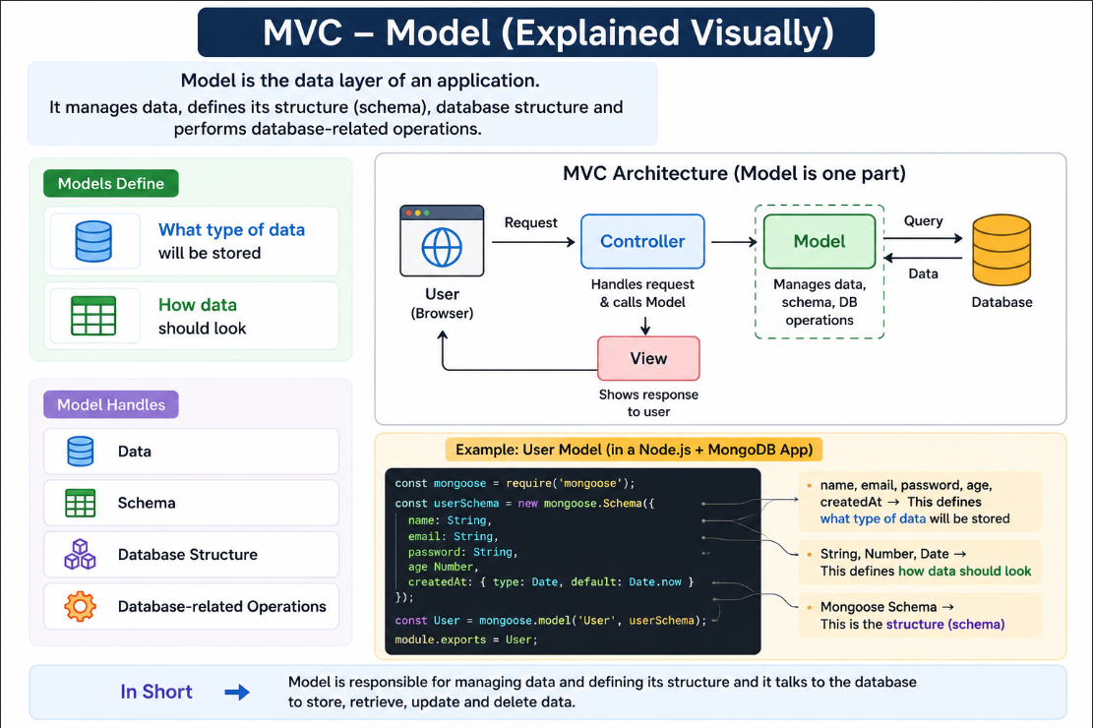
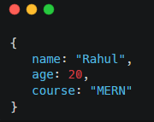
| MVC Architecture
Example :
Suppose we are storing student data.
The model defines:
which fields should exist
what type of data should be stored
how data should be organized
which fields are required
how student records should look inside the database

Slide 18
|
Suppose our backend application wants to store student data permanently.
Where will that data go?
And where should we write database connection code?

Slide 19
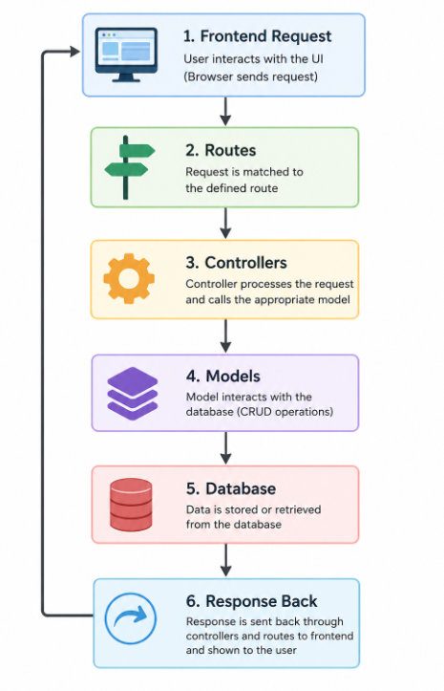
| MVC Architecture
Understanding Each Folder :-
4. Database Folder:
In professional backend applications, developers usually create a separate database folder to manage database connection setup.
This folder usually contains:
MongoDB connection code
database configuration
connection setup logic

Slide 20

| Check Your Understanding
Question : What is the main purpose of MVC Architecture in backend development?
Options : a. To increase internet speed b. To organize backend code properly c. To design frontend UI d. To install Node.js
Answer : b. To organize backend code properly
Explanation:
MVC separates backend application into different parts like:
Models
Views
Controllers

Slide 21
| Check Your Understanding
Question : Which MVC component contains the main backend logic?
Options : A. Models
B. Routes
C. Controllers
D. Database
Answer : C. Controllers
Explanation:
Controllers handle:
application logic
request processing
response handling

Slide 22
| Check Your Understanding
Question : What is the role of Models in MVC architecture?
Options : A. Handle frontend styling
B. Manage application data and structure
C. Start the server
D. Create routes
Answer : B. Manage application data and structure
Explanation:
Models are responsible for:
organizing data
defining data structure
interacting with database

Slide 23
| References
MDN Web Docs : Comprehensive and official documentation for Express Js 🔗https://developer.mozilla.org/en-US/docs/Learn_web_development/Extensions/Server-side/Express_Nodejs
W3Schools : Beginner-friendly express tutorials with examples and interactive editors. 🔗https://www.w3schools.com/nodejs/nodejs_express.asp
Express Official- A comprehensive tutorial-style website that covers core Express JS concepts in depth.
🔗https://expressjs.com/en/

Slide 24
Thanks
For
Watching
Course - Web Development - III
welcome@krmangalam.edu.in
Sohna Road,Gurugram,Haryana 122103

